Slide 1
Compact Townships and Urbanisation in Bangladesh
Professor Salim Rashid, UIUC

Slide 2
The Concept
An agglomeration of houses, hospitals, schools, markets, rural industries and local governmental units with all basic services for about 20,000 people.
It is to be largely self-governing and self financing.
The size is small enough for traffic within the CT and access by NMT.
MT will be isolated from the CT and make it environmentally friendly.

Slide 3
Why CT Needed?
Bangladesh is losing 1-2% of agricultural land every year for horizontal growth in housing.
Faster urbanization is attracting more migrants from the rural areas. Make urban areas less livable and less productive.
Unemployment in rural Bangladesh.
Organize the country’s economy for modern economic growth-which needs infrastructure.

Slide 4
Is rapid urban growth the key?
Optimistically, suppose the current urban areas double in size over the next 25 years. If 100 million continue in rural areas, we will still have about 40 million people without basic shelter! But, realistically, faster urbanization will attract even more migrants from villages, who will congest and swamp urban facilities, and make cities unlivable.
The root of a solution lies in providing urban facilities in rural areas.

Slide 5
Settlements in Narsingdi

Slide 6
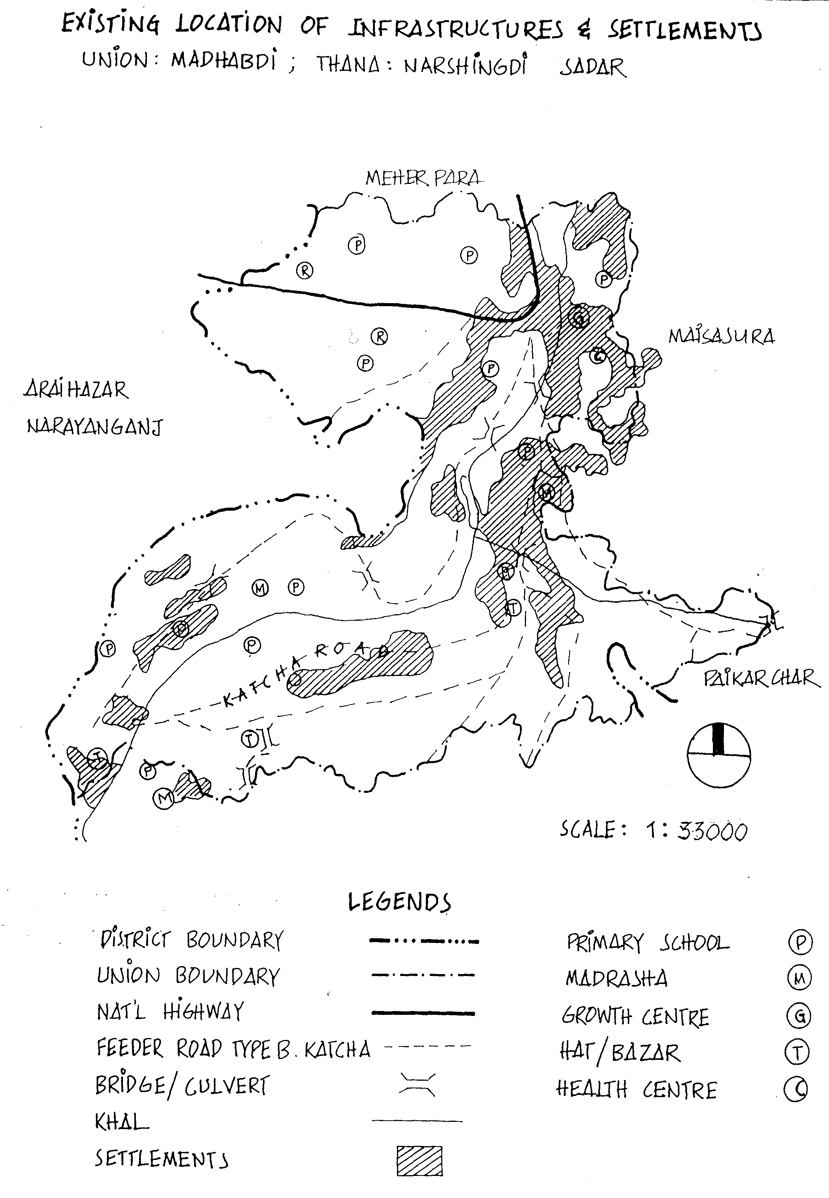
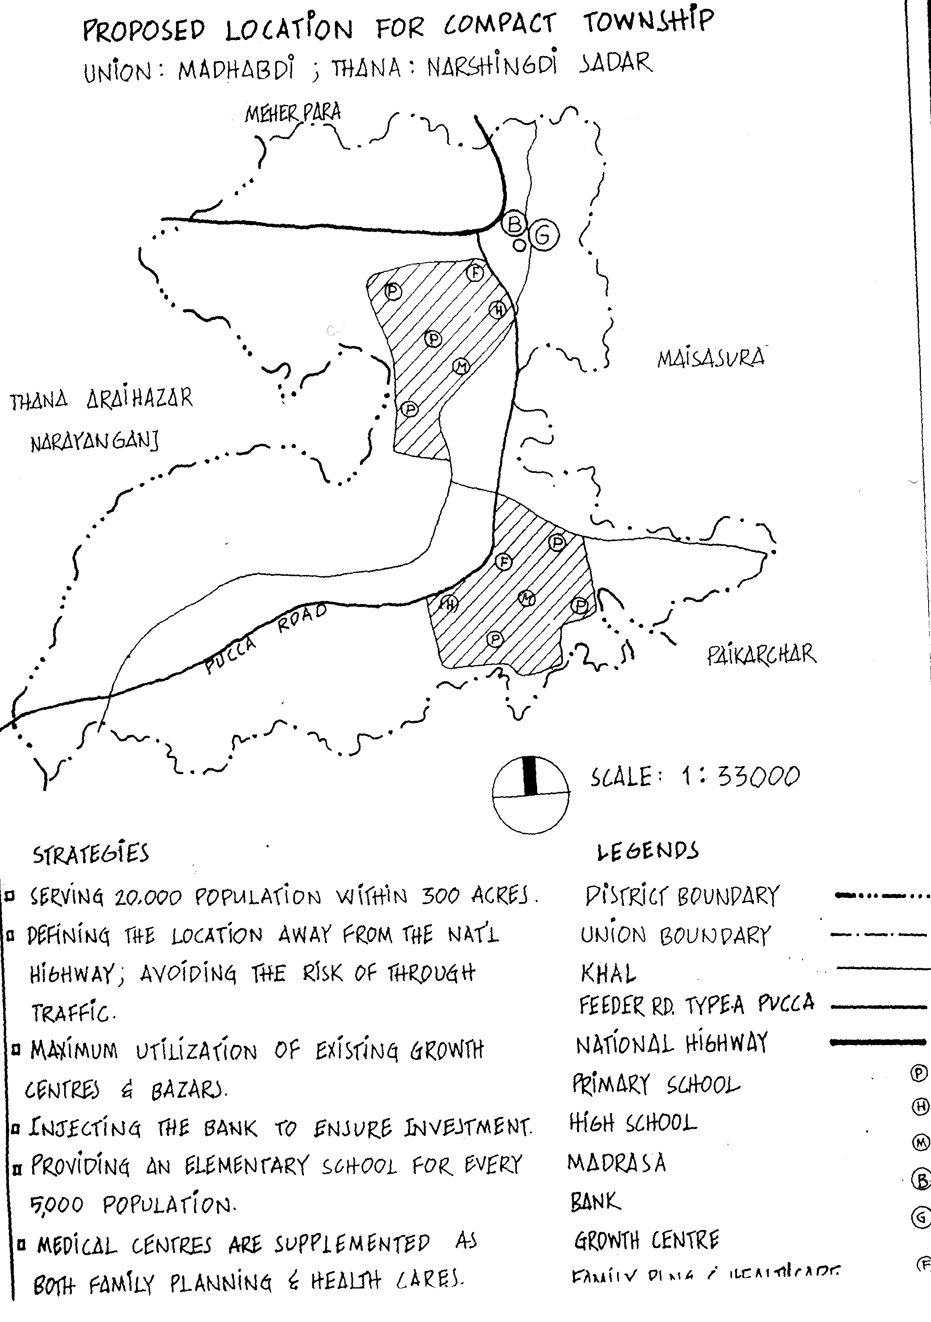
Madhabdi- Before and After

Slide 7
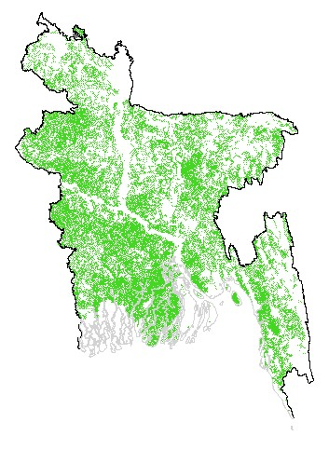
Bangladesh- D R R

Slide 8
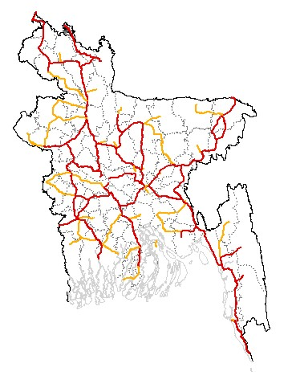
Bangladesh Rural Roads- ACT

Slide 9
CT in Numbers, 2025
4,500 CT for 90 million people
About 100 acres of land for each CT
$30-60 million for each CT
Self-financed for Tk1,000 (US$15) per month per 200 ft² of living space assuming 40 years loan at 0% interest.
Half the price per ft² of living space in Dhaka for slum or garment workers.

Slide 10
Savings by Implementing CT
Agricultural land---assume land use proportional to current population, savings via the output of lands saved and resultant effect on prices.
Savings on electric lines.
Savings on rural roads + Growth Centers
Savings on health ---travel and prevention—cooking and smoke
Savings on education---attendance and performance

Slide 11
Savings by Implementing CT
Savings on environmental pollution---auto exhaust from 90 millions
Savings on Flood control---benign neglect of embankments
Savings on Population growth---urbanized families have fewer children & on effectiveness of family planning with close contact
Benefits in terms of security especially for minority populations.
Employment multiplier
Rural Urban migration inflow costs.

Slide 12
WB Forecast on Investment Requirement in 25 Years (in Billion US$)
Sectors | Annual Average | Total
Social Sector | 1.0 | 25
Urban Housing and Infrastructure | 4.0 | 100
Physical Infrastructure | 3.0 | 75
Industry and Agriculture | 4.0 | 100
Environment and Other | 1.0 | 25
Total | 13.0 | 325

Slide 13
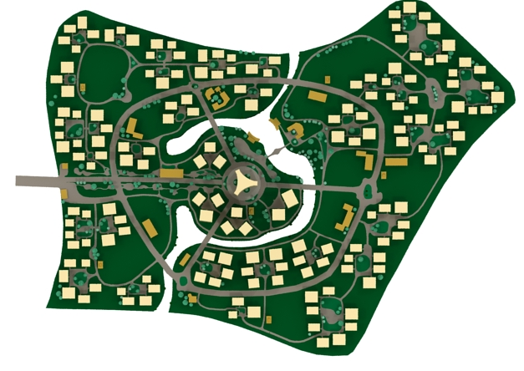
A Model Advanced CT

Slide 14
Investment Opportunity
Sector specific or cumulative
Huge savings in infrastructure
Easy implementation and monitoring
Huge private sector potential
GoB needs to enable—need NOT construct

Slide 15
What are some possibilities?
1 Transport oriented---Miyabazar
2 Production oriented---Garments relocation in general
3 Eco-tourism oriented—Shoron Khola
4 Poverty oriented---4 cow model eg Mymensingh
5 Leisure and history oriented---Kaliakor
6 Mining oriented---Phulbari
7 Rice, water and electricity oriented—Aman and Aus lands in general---need agr highlands wch are now peopled---so that HYV is shifted to rainfed rice
8 Remittance oriented---Satura

